Slide 1
Python app to design EBSD based model

Slide 2
The EBSD ‘interfaces reconstructed’ exported file can possess a lot of points very close from each other.
The automatic process of OIM that cleans the EBSD map, should be tested with a variety of parameters. This process is time consuming.
The purpose of this small app, is to avoid these tests and generate the simplest model based on one EBSD ‘.png’ image.
The implemented routine has a manual step of selecting the desired lines and also includes an automatic process that records the desired lines on a file to be read in Matlab_comsol routine.

Slide 3
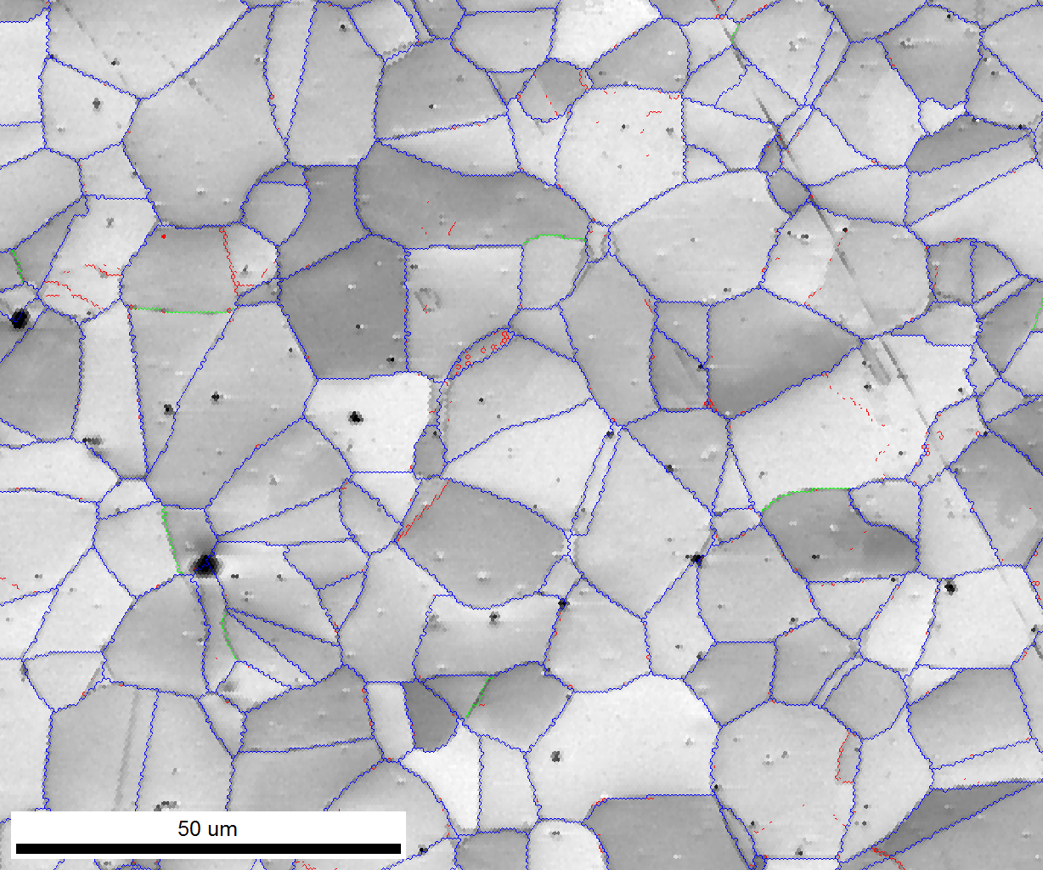
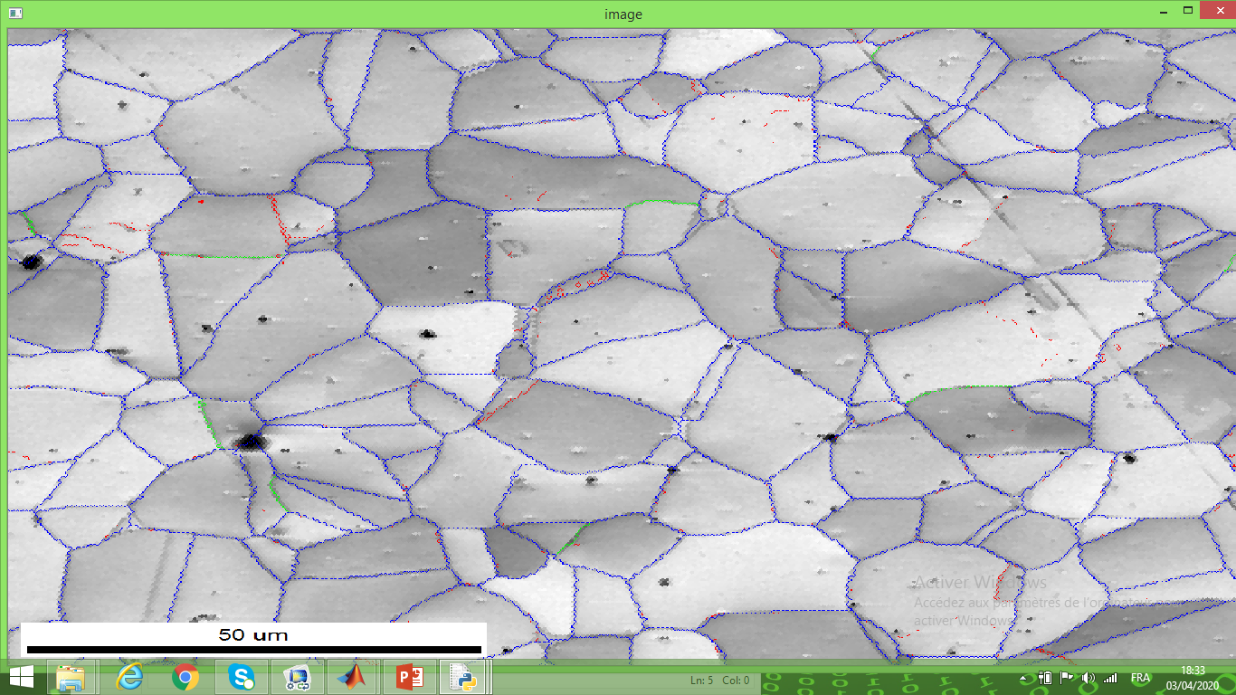
The program will ask for:
image.png name
width, maximum x in micrometers
height, maximum y in micrometer
model_manual_design.py
script
One window will be opened with the image.
Input: image.png

Slide 4
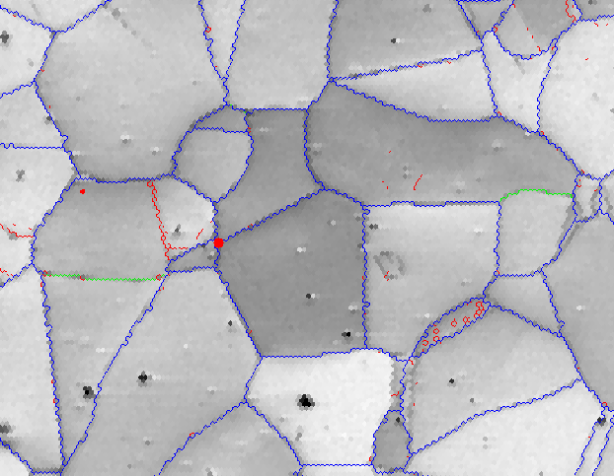
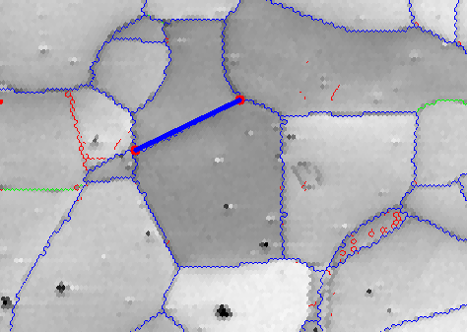
The script will recognize the number of pixels in the two directions.
One window will be opened with the image.
Instructions:
1. The operator should give one left click at any interface to create the first point, the selected point will be marked in red.
2. To continue, the operator will give the second left click on one adjacent point, then a blue segment will be marked between these points. This blue segment will be recorded at the “out.txt” file

Slide 5
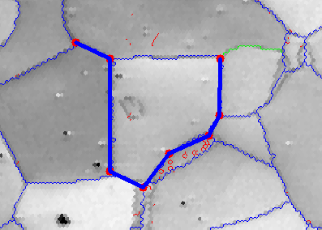
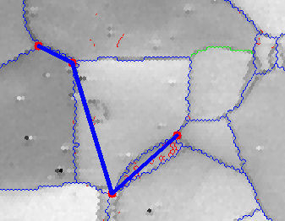
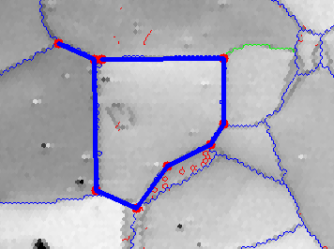
3. To continue, the operator should go clicking following the adjacent edges, without crossing the grains.
CORRECT WAY
WRONG WAY
They are recorded as the same point
4. To close the grain, you can click at the point that is already selected. If it is hard to put the cursor exactly at the point to close, you can click beside the point. The program will recognize that two red circles very close from each other are the same point.

Slide 6
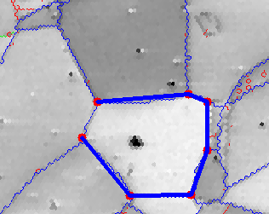
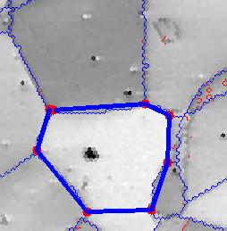
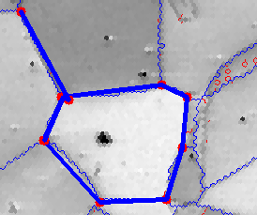
5. If you have to come back by the same way, there is no problem, the program will not record the same line in the opposite direction.
Recording
this
movement
Already
recorded
movement

Slide 7
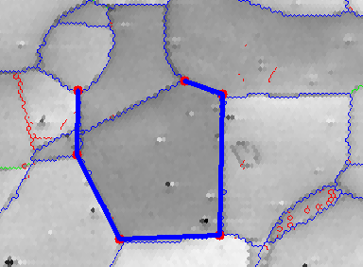
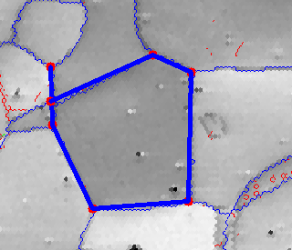
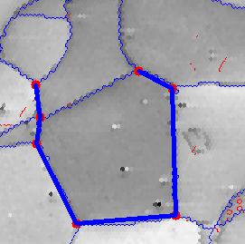
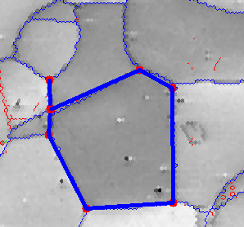
WRONG WAY
6. It is not possible to insert a point in the middle of a recorded line. You should make one additional point before closing the domain.
CORRECT WAY

Slide 8
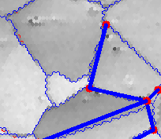
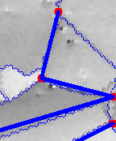
7. If you are close to the edge, avoid creating new segments. Extend the line until the end, if it is possible. This will avoid future meshing problems.
WRONG WAY
CORRECT WAY

Slide 9
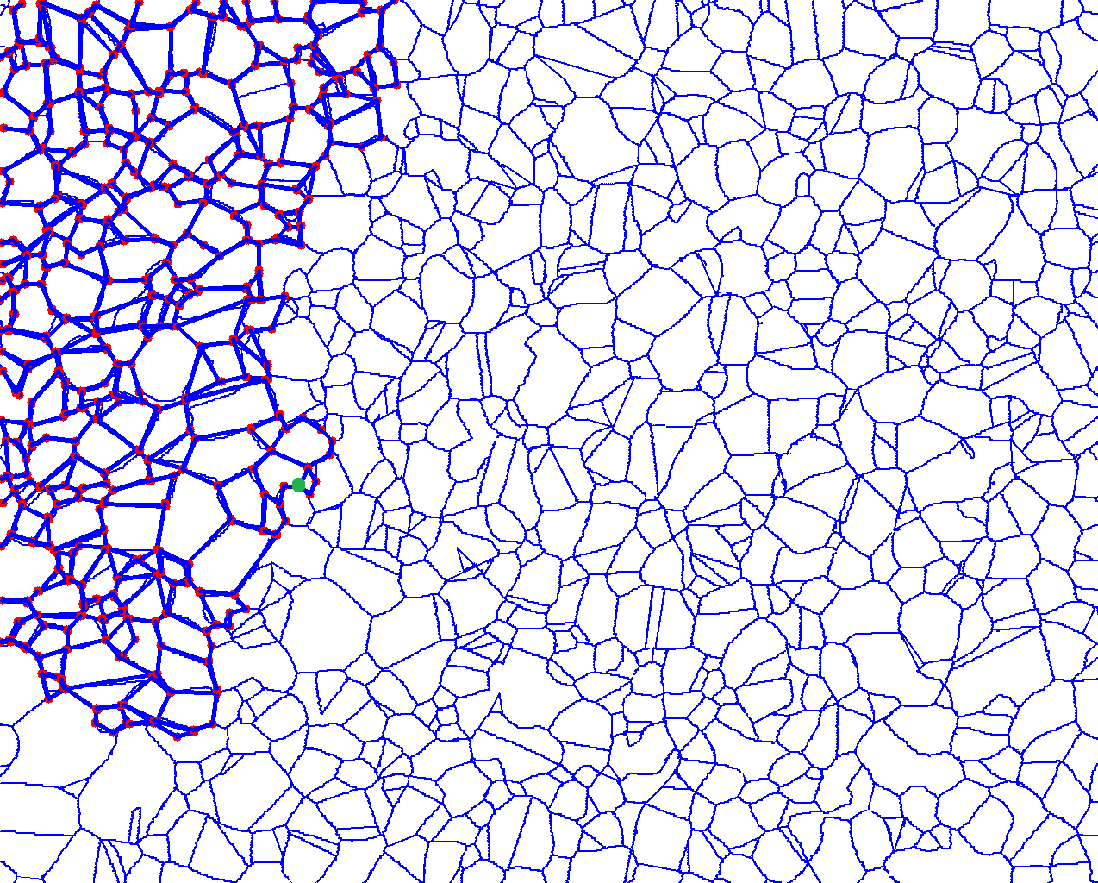
You can save your progress by typing ‘esc’, then you can open the pixels_coordinates.txt file, where you can check the last clicked pixels.
You can search the last pixel in points.png with the KolourPaint cursor, then you can draw one circle on this pixel , and use it as a new import file. You should begin the new design by clicking this last pixel.
At every new run the script will generate:
The pixels coordinates of clicked pixels,
(x,y cursor positions) in this specific run,
on pixels_coordinates.txt
The coordinates of segments in micrometers,
X1 y1 x2 y2 at each line.
If you take more than one run, you should combine the pixel coordinates of each run in the script “final_assembly.py” input file of COMSOL.

Slide 10
8. When finished, press ‘esc’ to register the file. The ‘out.txt’ file will be generated.
The ‘out.txt’ file differs from the OIM cleaned file, there are no header and only 4 columns : x_left, y_left, x_right and y_right , the unity is micrometer.
Disadvantage: manual process
Advantage : 320 lines in text.out , instead of 524 with generated with OIM cleaning.
Total control of geometry and comprehension of errors to avoid them
9. The program also exports the final image with the selected points and lines; the file “points.png”
10. If some mistake is done; you can use the script “model_small_change.py” to know which data line in “text.out” correspond to a segment, than you can manually edit the file to add or delete a specific segment.

Slide 11
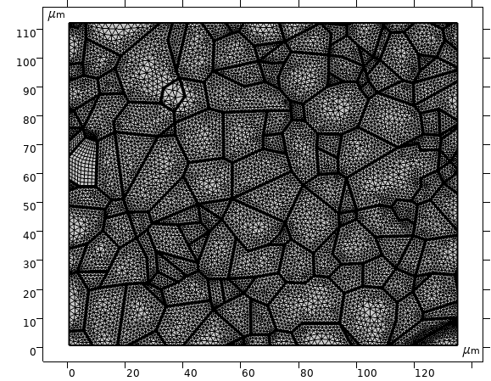
Real
Model

